Slide 1

Amazon Sales Data Analysis
High Level Design

Slide 2
Document Version Control:
Date Issued | Version | Description | Author
28/01/23 | 1.0 | Final Version of Complete LLD | Himanshu Pewal

Slide 3
ABSTRACT:
Amazon Sales Management is looking for improved methods to increase sales and profits. The management has asked to create sales report on Yearly, Monthly Sales Trend to understand the market behavior. They’re looking for relationships between different variables that directly affect sales
Amazon Sales Management is looking for improved methods to increase sales and profits. The management has asked to create sales report on Yearly, Monthly Sales Trend to understand the market behavior. They’re looking for relationships between different variables that directly affect sales

Slide 4
1 INTRODUCTION:
Why this High-Level Design Document?
The purpose of this High-Level Design (HLD) Document is to add the necessary detail to the current project description. This document is also intended to help detect contradictions prior to coding/visualizations, and can be used as a reference manual to understand the though process behind creating visuals.
The HLD will:
Present all of the design aspects and define them in detail.
Describe the user interface being implemented.
Describe the hardware and software interfaces.
Describe the performance requirements .
Include design features and the architecture of the project.
List and describe the non-functional attributes like:
Security
Reliability
Maintainability
Portability
Reusability
Application compatibility
Resource utilization

Slide 5
SCOPE:
The HLD documentation presents the structure of the system, such as the data architecture, application architecture (layers), application flow (Navigation), and technology architecture.
The HLD uses non-technical to mildly-technical terms which should be understandable to the administrators of the system.

Slide 6
GENERAL DESCRIPTION:
2.1 Business Perspective & Problem Statement
Amazon is a global e-commerce brand establishing businesses across the world. The stakeholders are looking to understand market behavior and sales trend to gain a competitive advantage.
The objective of the project is to create a report on Sales trend year-wise, month-wise to understand the factors directly affecting the sales. This project aims apply Business Intelligence tool such as Power BI to get a visual understanding the sales data.

Slide 7





TOOLS USED:
Programming Language: Python
Python Libraries: NumPy, Pandas
Business Intelligence Tools: Excel, Tableau

Slide 8
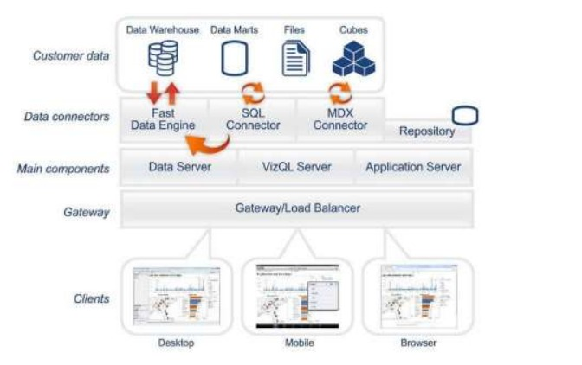
Design Details:
Figure 1: Functional Architecture of Business Intelligence

Slide 9
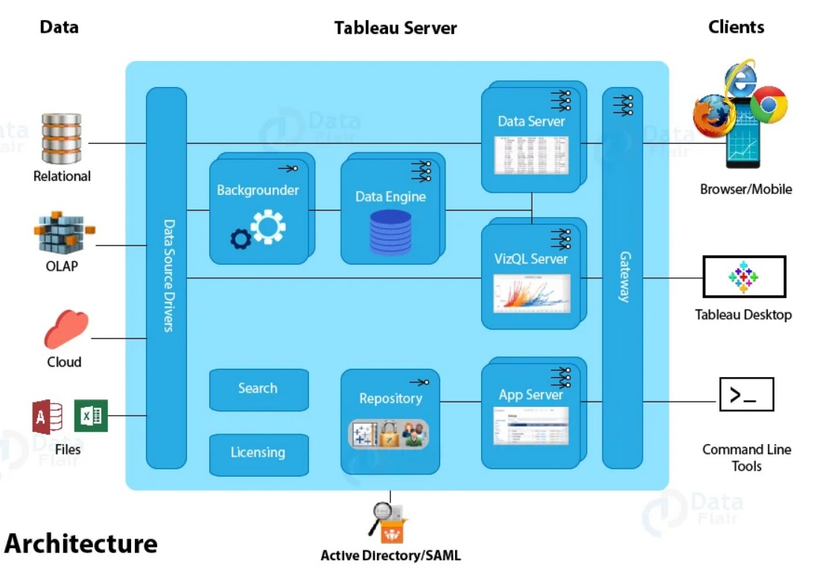
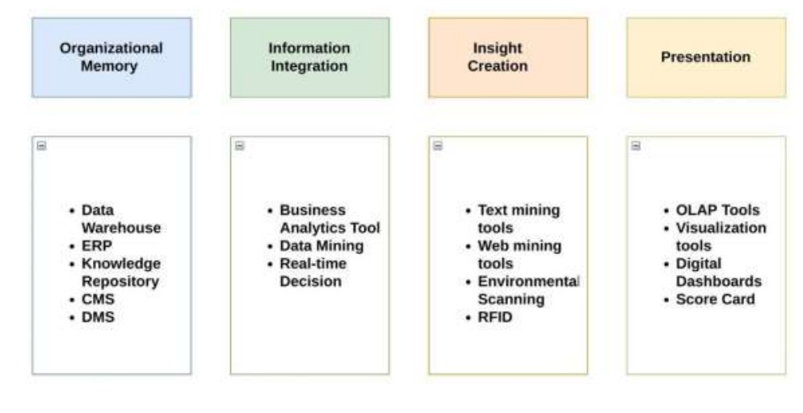
HOW TABLEAU WORKS:
Tableau has a highly scalable architecture that serves mobile clients, web clients and desktop installed software. Tableau architecture supports fast and flexible report and dashboard creation to drive business insights.

Slide 10
OPTIMIZATION
1.Your data strategy drives insights.
Cleaning Data by imputing missing values or removing missing values.
Changing and converting the column data types.
Creating measures to create values for simple card views. Optimize space to ensure every chart or visuals is fitting and telling the same story.
2. Reduce the marks (data points) in your view.
Practice guided analytics. There’s no need to fit everything you plan to show in a single page. Compile related visuals and connect them with action filters to travel from overview to highly-granular views at the speed of thought.
Creating charts that explore relationship between different variables in the dataset.

Slide 11
What is KPI in Tableau?
Key Performance Indicators or KPIs, in general, are the metrics and values that show how well an organization is performing based on its key business objectives.
We can divide these KPIs into two different categories, high level, and low level. High-level KPIs focus on the overall growth and performance of the company, while low-level KPIs are focused on the workflow or process of each department such as development, sales, HR, marketing, operations, etc.
How to create a Tableau KPI Dashboard?
To create a KPI dashboard in tableau, you first have to prepare the dataset and transform it into the desired format.
Then comes the visualization part that converts the dataset into figures like charts, histograms, maps, scatter plots, and more.
Following that, you apply some filters, create measures and to provide more information using a single figure.
At last, put all the KPIs in a single dashboard and share it with other users on the Tableau server.

Slide 12
DEPLOYMENT:
Prioritizing data and analytics couldn’t come at a better time. Your company, no matter what size, is already collecting data and most likely analyzing just a portion of it to solve business problems, gain competitive advantages, and drive enterprise transformation. With the explosive growth of enterprise data, database technologies, and the high demand for analytical skills, today’s most effective IT organizations have shifted their focus to enabling self-service by deploying and operating Tableau at scale, as well as organizing, orchestrating, and unifying disparate sources of data for business users and experts alike to author and consume content.

